Slide 1

Midterm semester project presentation
Automated propeller geometry measurement from 3d scanning data
LIS
Supervisors :
S. Steffen
A. Bhaskaran
Author:
P. Maury Laribière

Slide 2
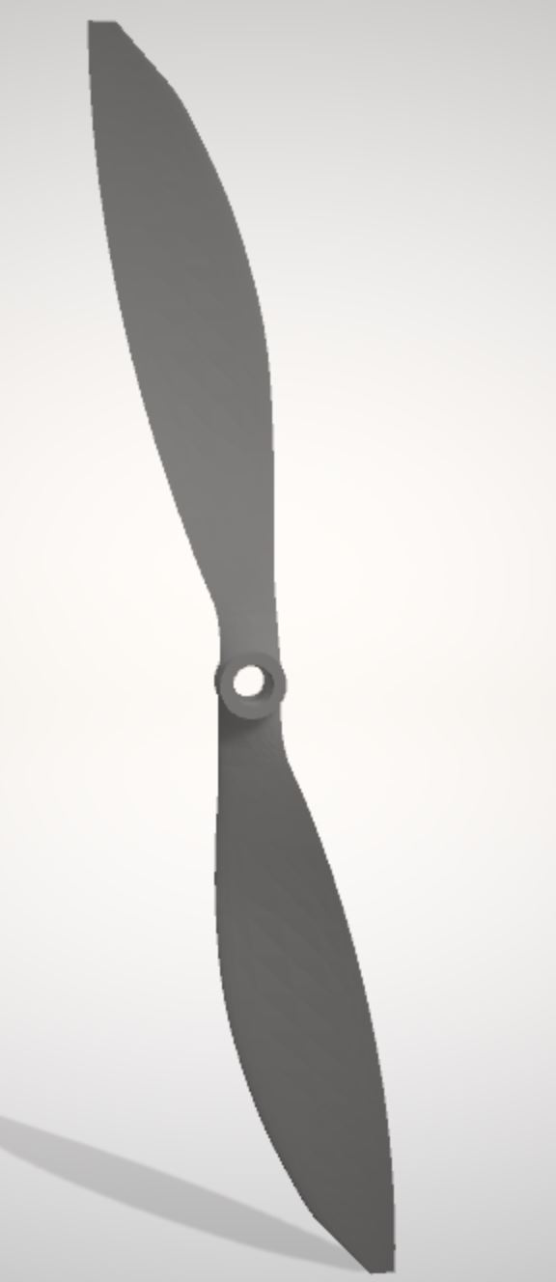
Introduction
Analysis of the performance of drones is a very active field of research
No automated method
Wind tunnels
Blade Elementum Theory needs geometry information
3D scanning technologies
Greatly developed in past years
Fig.1: Propeller STL file from 3D scanning

Slide 3
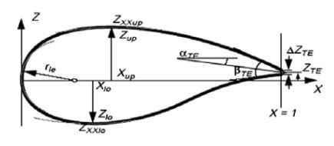
Introduction: state of the art
3D scanning: 5 main techniques
Aerofoil parametrizations:
Contact
CMM
Non contact active
Structured Light
Time of flight
Laser triangulation
Non contact passive
Photogrammetry
Bézier
PARSEC
Bezier - Parsec
Sobieczky (with PARSEC)
Improved Parameter Geometric
Fig 2: PARSEC parametrization parameters
From Airfoil Parameterization Techniques: A Review,
Nilesh P. Salunke, Juned Ahamad R. A.2, S.A. Channiwala2

Slide 4
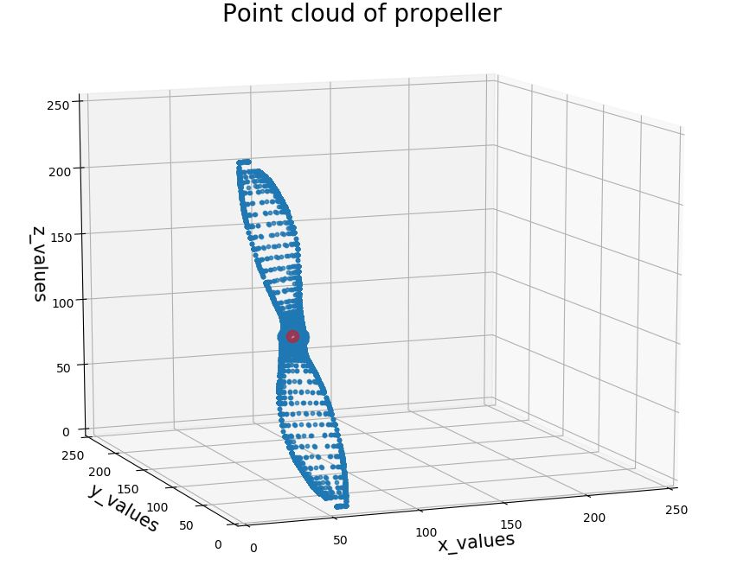
Introduction: goal of the project Automated propeller geometry measurement from 3d scanning data
Reverse engineering aerodynamics of propellers from 3D scanning data
Point cloud processing
Projections for Xfoil software
Parameters
Automation of 3D scanning
Study of procedures
Fig.3: Point cloud of propeller

Slide 5
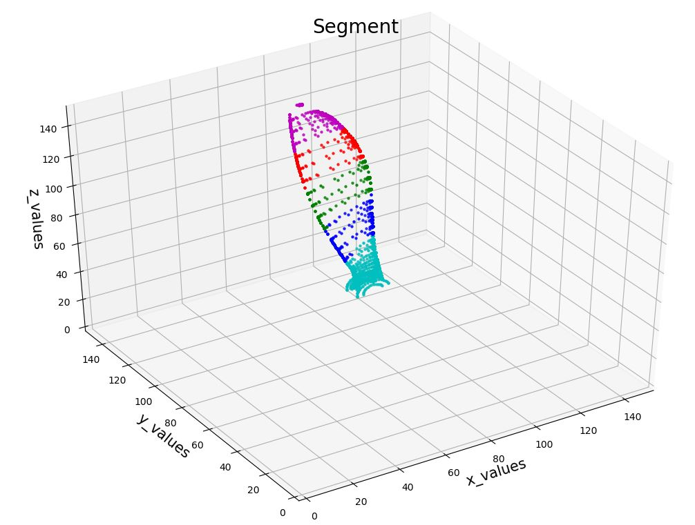
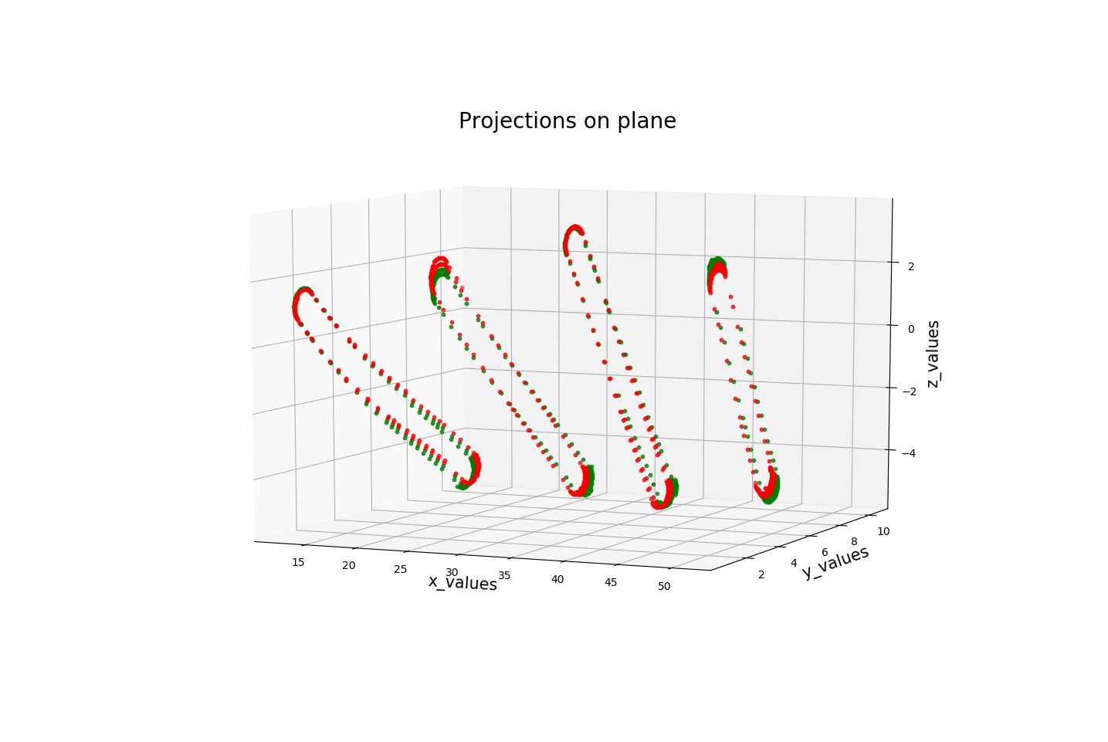
Method: algorithm (done)
STL to CSV
Find equation of planes
To segment file
Extract point in-between each plane
Project point on plane
Regarding upper and lower points
Steps :
Fig.4: Segments of propeller
Fig.5: Projections on plane

Slide 6
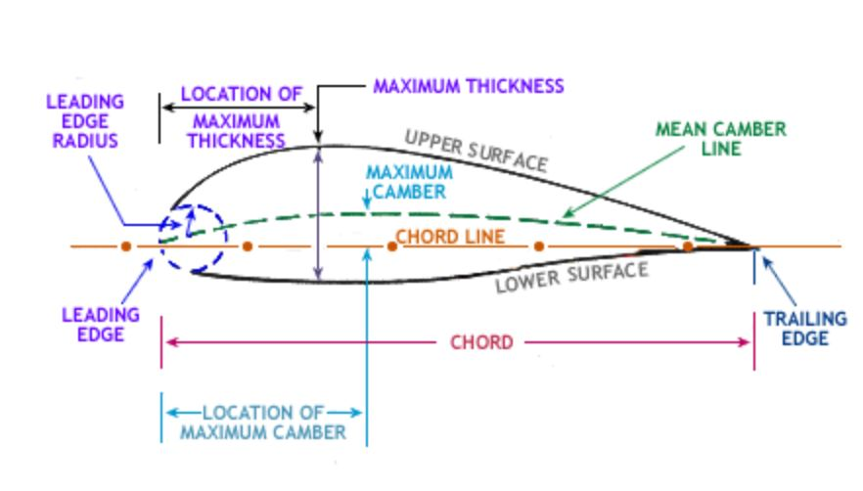
Method: algorithm (to be done)
Finish projections
X-foil software
Lift and drag characteristics
Find parameters
Hub radius, blade twist, chord length etc.
Develop process for automation of propeller 3D scanning
Study procedures
Fig.6: Parameters of propeller from http://wwwaeroforum.blogspot.com/

Slide 7
Conclusion
Issue to know how to project (pair of points)
Using 3D scanning data for reverse engineering is very promising
Many choices of parametrizations of propellers and scanning methods

Slide 8
Thank you for your attention

